Slide 1
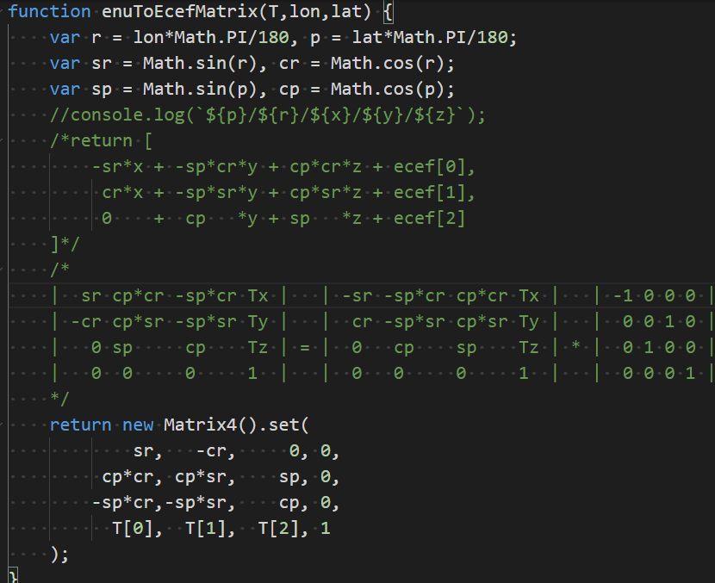
ENU(Sphere) To ECEF(WGS84)
// proj4.defs('EPSG:4978' ,'+ellps=WGS84 +proj=geocent +units=m +no_defs +datum=WGS84' ); //ECEF of ellipse
// proj4.defs('EPSG:sphere','+ellps=WGS84 +proj=geocent +units=m +no_defs +a=6378137 +b=6378137'); //ECEF of Sphere
const T = proj4('EPSG:sphere', 'EPSG:4978', [-index.center.z,index.center.x,index.center.y]);
const enuToEcef = enuToEcefMatrix(T, index.center.lon, index.center.lat);
// apply mesh from enu to ecef
groupMesh.applyMatrix4(enuToEcef);

